Slide 1
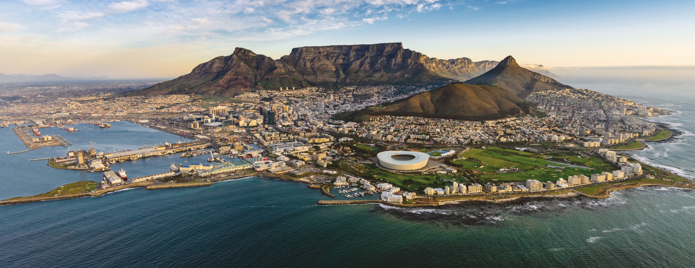



International Corrosion Congress
Cape Town | South Africa
9-13 November 2027

Slide 2
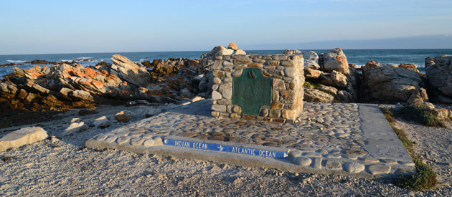
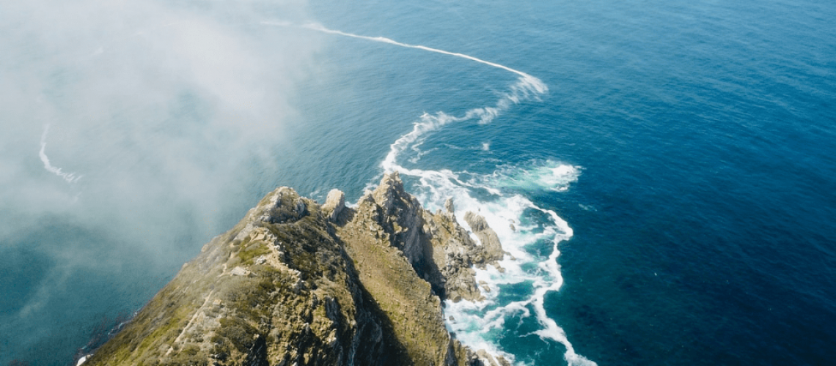
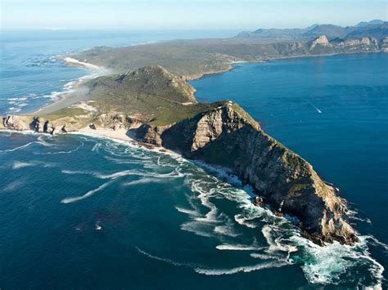
“When brilliant minds collide, they’re ordained for greatness. When they form relationships with people they wouldn’t have met, it opens up more connections with people who might collaborate on research projects that will change the world.” ― Colin Webb

Slide 3
Cape Point
Table Mountain
City Centre (CBD)
Convention Centre
V&A Waterfront
an inspiring place to meet

Slide 4
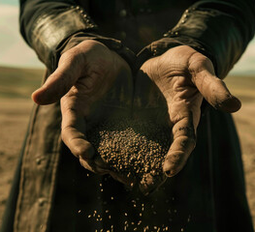


700 euros per delegate

Slide 5
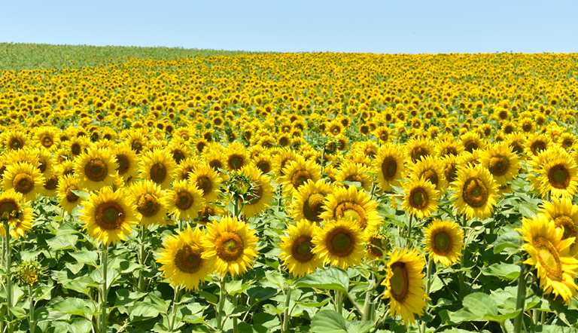
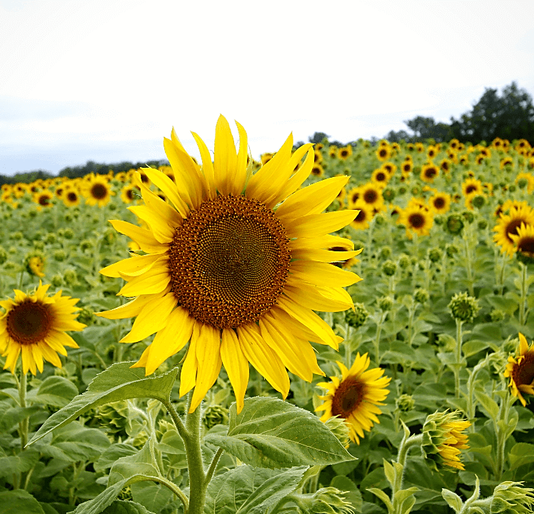
13500 Euros for ICC

Slide 6

South Africa
Inspiring new ways

Slide 7


2027
International
Corrosion Congress
South Africa awaits…

